Slide 1





SOAP Request -→ DBS
FIFO Queue
Consumes metadata from SQS
metadata
Consumes metadata from SQS
Identify S3 file location of Actual payload (JSON) thru metadata sent by Consumer
Process the payload data & update the Actual business tables accordingly.
SOAP → JSON Converter
JSON param
Producer→ SQS
SQS → Consumer
Receive SOAP request
Unmarshall → JAXB
JAXB → Domain Object
Domain Object → JSON
Receive JSON (payload)
Grab metadata from Payload
Stores complete payload to S3
Sends metadata along with S3 location to SQS
Get the actual payload from S3
JSON payload

Slide 2





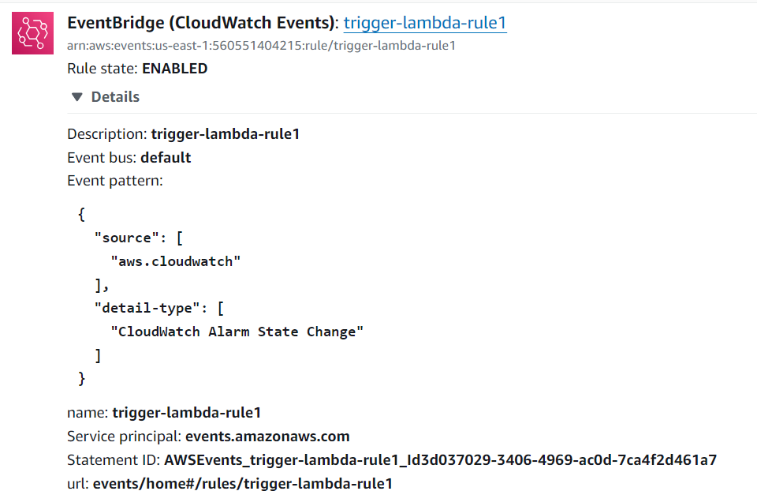

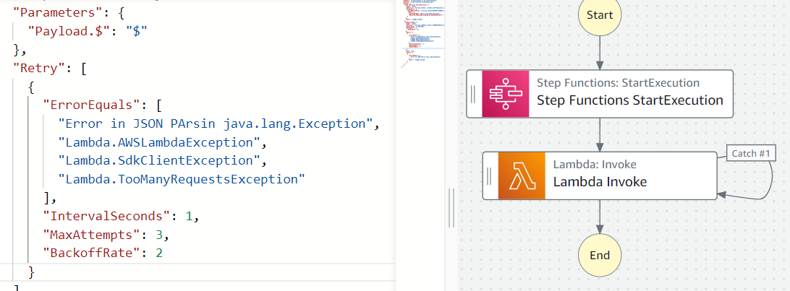

Consumer Unmanaged Exception Handling process flow
FIFO Queue
If any Exception Occurs after message Consumption & during processing message
Consumes metadata from SQS
Exception will get logged into CloudWatch log group
Alarm Triggers
SQS → Consumer
Retry Consuming the unprocessed message
AWS Step Function

Slide 3




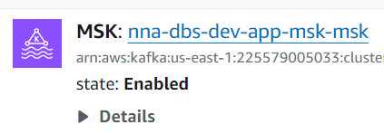
Consumer Unmanaged Exception Handling process flow
Lambda Invocation thru MSK Event (1)
If any Exception Occurs after message Consumption & during processing message, It will do 3 / more retry (2)
Consumer
3b
Exception will get logged into CloudWatch log group
4
3a
Alarm Triggers
Lambda will pick unprocessed messages & process it. Bucket will be flushed once processed
AWS Step Function
Will do Retry until the Error State exists
5c
Enable ESM
5a
5d
5b
Disable ESM

Slide 4
Consumer Unmanaged Exception Handling process flow
Kafka Listener triggers
Consumer
If any Exception Occurs after message Consumption & during processing message, It will do 3 / more retry (2)
3b
Exception will get logged into CloudWatch log group
4
3a
Lambda will pick unprocessed messages & process it. Bucket will be flushed once processed
Alarm Triggers Lambda to call microservice endpoint
5b
Enable Kafka Listener thru Endpoint Registry
5c
5a
Disable Kafka Listener thru Endpoint Registry
Next / below Page depicts the Implementation / Approach to start & Stop @kafkaListener in ECS dynamically.

Slide 5
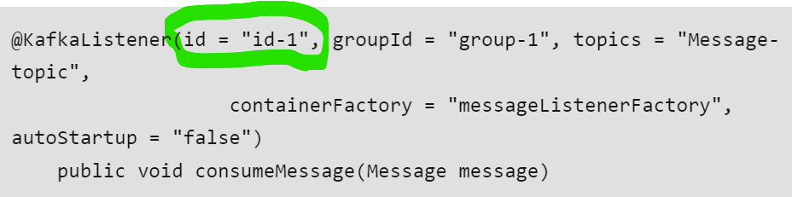
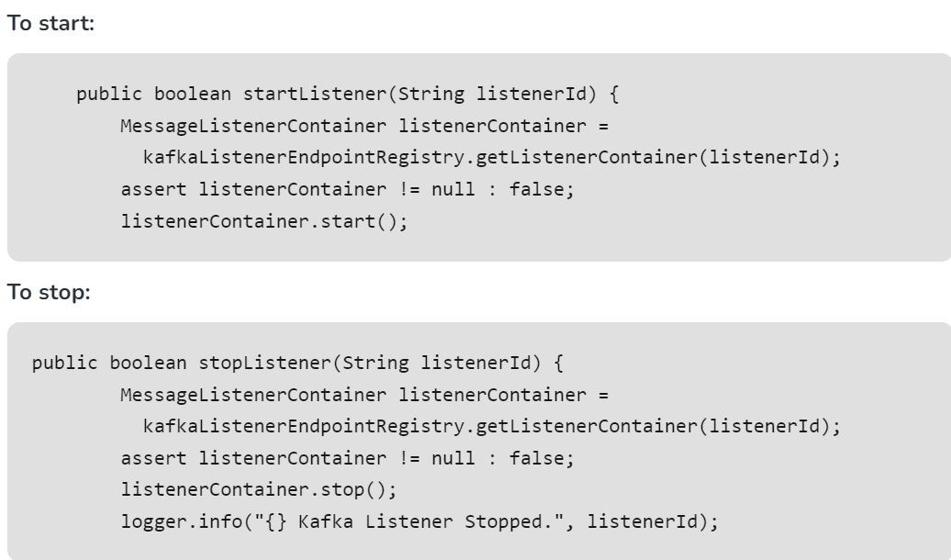
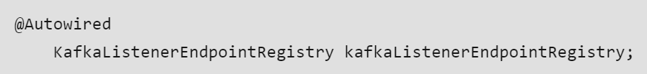
Approach to start & Stop @kafkaListener in ECS dynamically.
Use case: Need to disable / stop kafka listener when there is a long downtime DB / MQ when processing the consumed messages. Once the DB / MQ downtime got resolved & up then we need to star the kafka listener again.
NB: Kafka Listener can be enabled & disabled thru it’s listener id
Approach: (Reference link for complete code: Spring Boot - Start/Stop a Kafka Listener Dynamically - GeeksforGeeks)
Step 1: Add the Kafka ID property when registering the listener as below
Step 3: Have the below methods to Start & Stop the Listener dynamically
Step 2: Add the below Entry point Registry

Slide 6
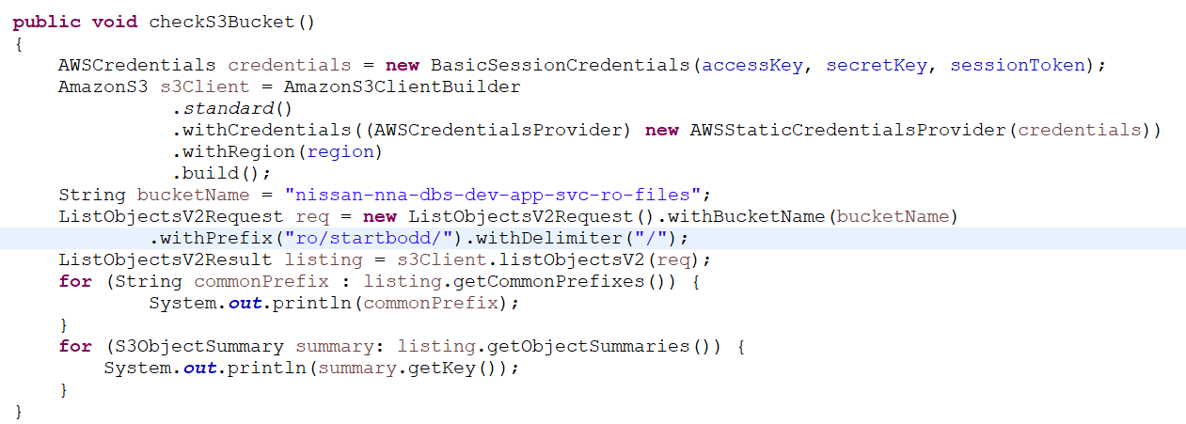
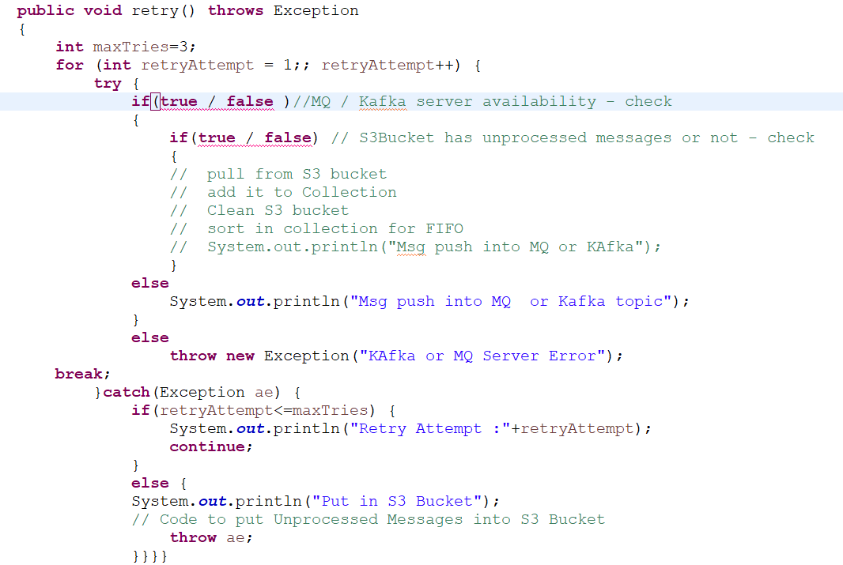
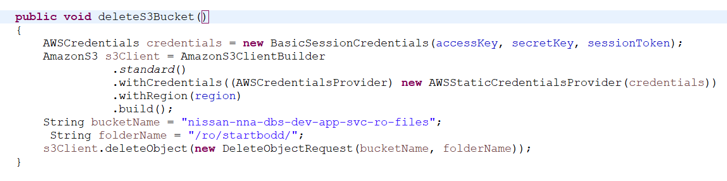
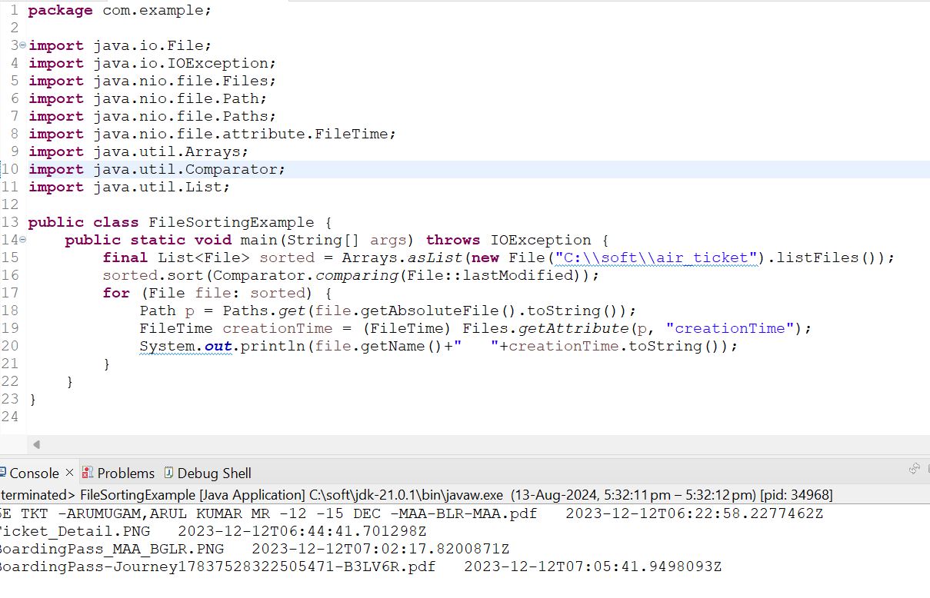
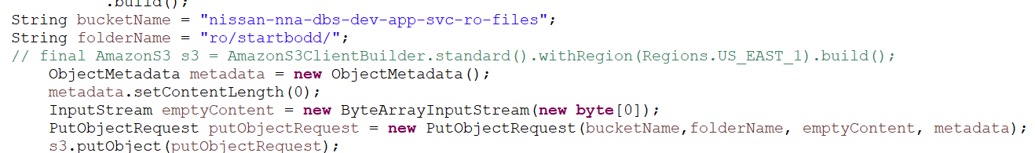

Slide 7
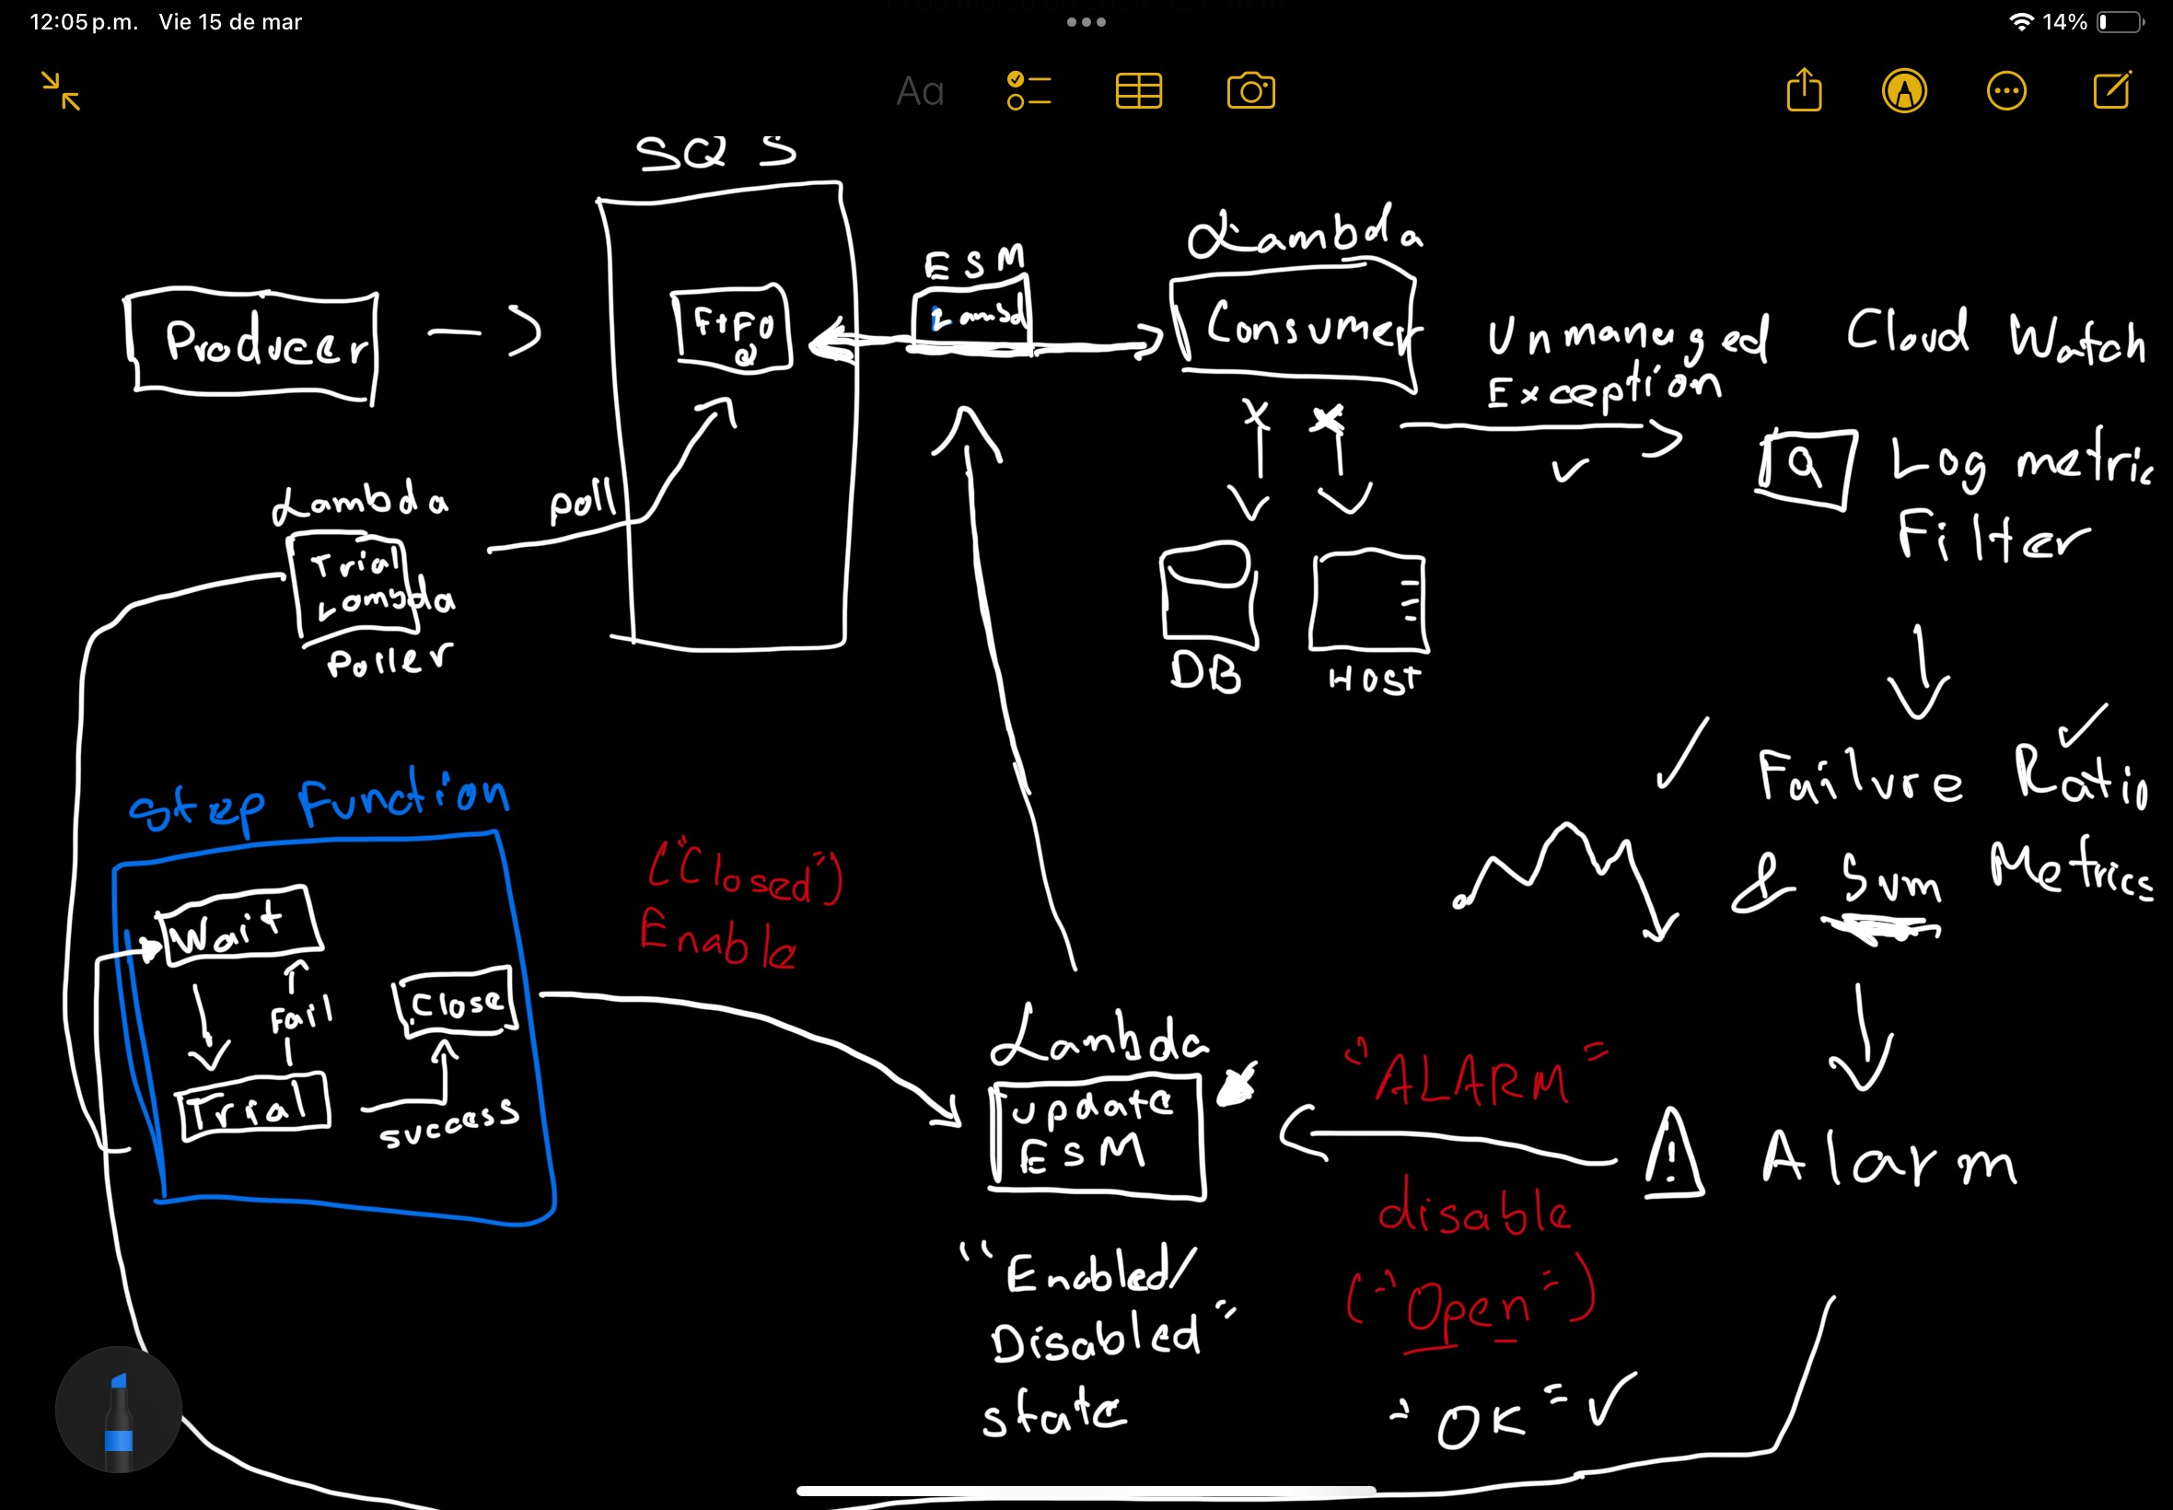

Slide 8
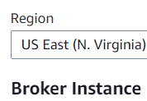
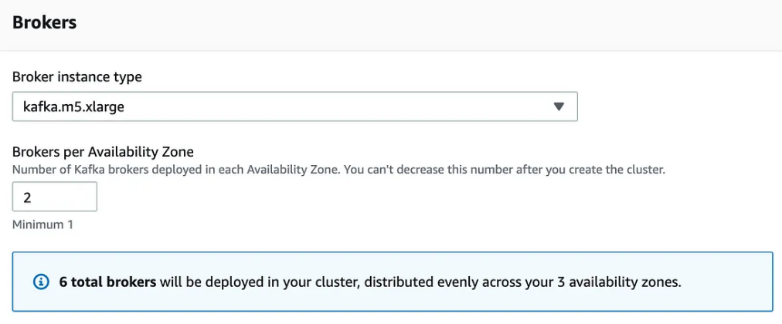
AWS MSK configuration – Use Case 1
configuration
Result
6 m5.large machine
# of Topic 1
Replication Factor 1
# of Partition 6
Testing with 500K records
Max record rate: ±90K rec/sec (90 MB / sec)
Avg latency: 302 ms
Max latency: 600 ms
Overall throughput would process 100K rec/sec

Slide 9
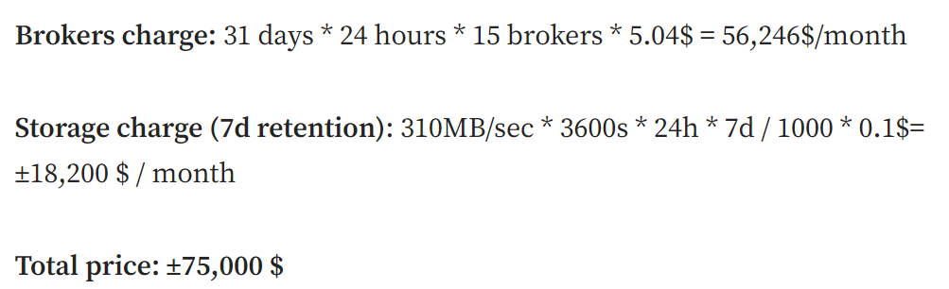
AWS MSK configuration – Use Case 2
Cluster size: 15 brokers
Machine type: kafka.m5.12xlarge
Partitions per topic: 15
Replication factor: 1
Max record rate: ±310K rec/sec (310 MB /sec)
Avg latency: 103 ms
Overall throughput would process 500K rec/sec

Slide 10
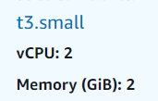

AWS MSK configuration – Use Case 3
Expected throughput would process 5K rec/minute
Configuration
Storage : 100GB/ Borker
3 Borker * 100 GB * 0.10 USD = 30 USD
Inbound Data Transfer : 100 GB / month
Intra Region Transfer: 100 GB / month
Multi VPC :
# of Authentication Schemes – 2
Data process / connectivity: 2 GB / hour
3 Borker nodes
# of Topic 1
Replication Factor 1
# of Partition 5
Testing with 1K records / minute
Monthly Cost

Slide 11
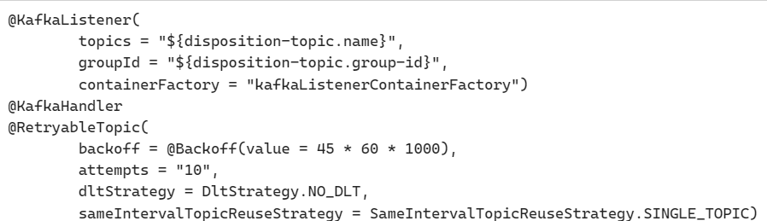
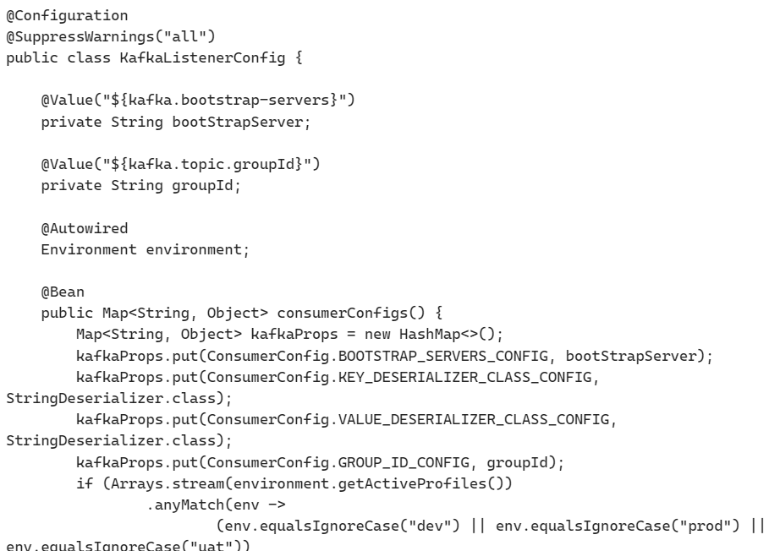
Kafka Listener Config
Kafka Retry Config on Broker Failover

